Slide 1

RAILWAY MANAGEMENT SYSTEM
RAILWAY MANAGEMENT SYSTEM
Submitted By:-
Archit
Arpit
Aryan
Ashish
Davy
Gajendra
Gurdeep
Karan
UE203020
UE203022
UE203025
UE203026
UE203033
UE203038
UE203042
UE203054
Submitted To:-
DR.Mamta Juneja
Associate Professor ,CSE Department
UIET, Panjab University Chandigarh (160014)

Slide 2
SQL COMMANDS
DDL
CREATE
ALTER
DROP
DESC
TRUNCATE
COMMENT
RENAME
DML
SELECT
INSERT
UPDATE
DELETE
DCL
GRANT
REVOKE
TCL
COMMIT
ROLLBACK
SAVEPOINT
SET TRANSACTION

Slide 3
DDL(DATA DEFINITION LANGUAGE)
DDL changes the structure of the table like creating a table, deleting a table, altering a table, etc.
All the command of DDL are auto-committed that means it permanently save all the changes in the database.
It deals with database schemas and descriptions, of how the data should reside in the database.

Slide 4
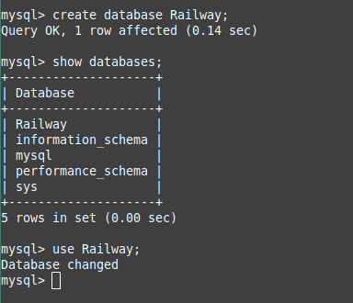
CREATE COMMAND
To create a database and its objects like (table, index, views, store procedure, function, and triggers).
To create new database –

Slide 5
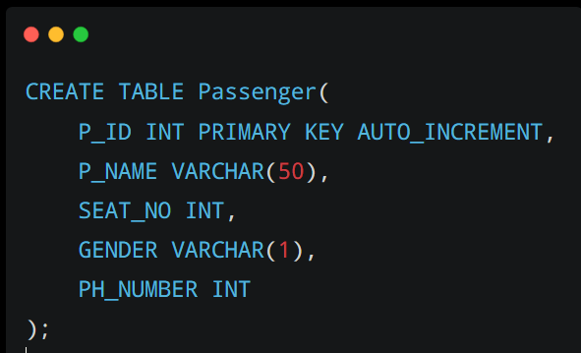


2. To create new table in a database

Slide 6
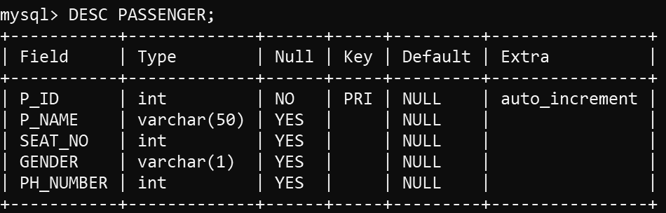

Introducing our all tables
Passenger_Table

Slide 7
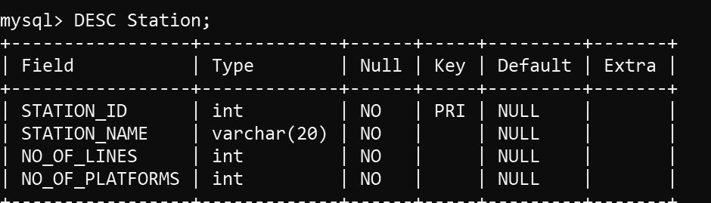
Station_Table

Slide 8
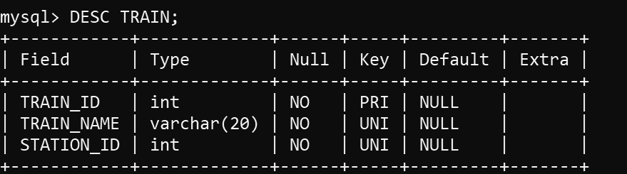
Train_Table

Slide 9
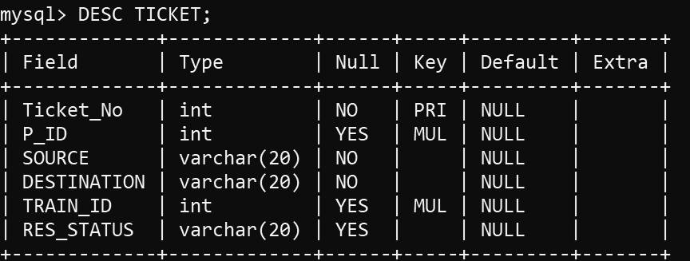
Ticket_Table

Slide 10
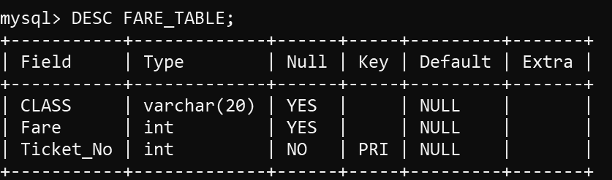
FARE_TABLE

Slide 11
RESERVE TABLE
Reserve Table: It used to sketches all reserved ticket with their required attributes like status of booked ticket , date of booking , no of seats, address of passenger, and their contact details.
ATTRIBUTE
PNR_No : Foreign Key from Reserve Relation , referencing Passenger Relation.
Journey_date
No_of_seats: Tells the no of seats booked by Passenger
Address
Contact_No
Status : Shows status whether ticket is reserved or not.

Slide 12
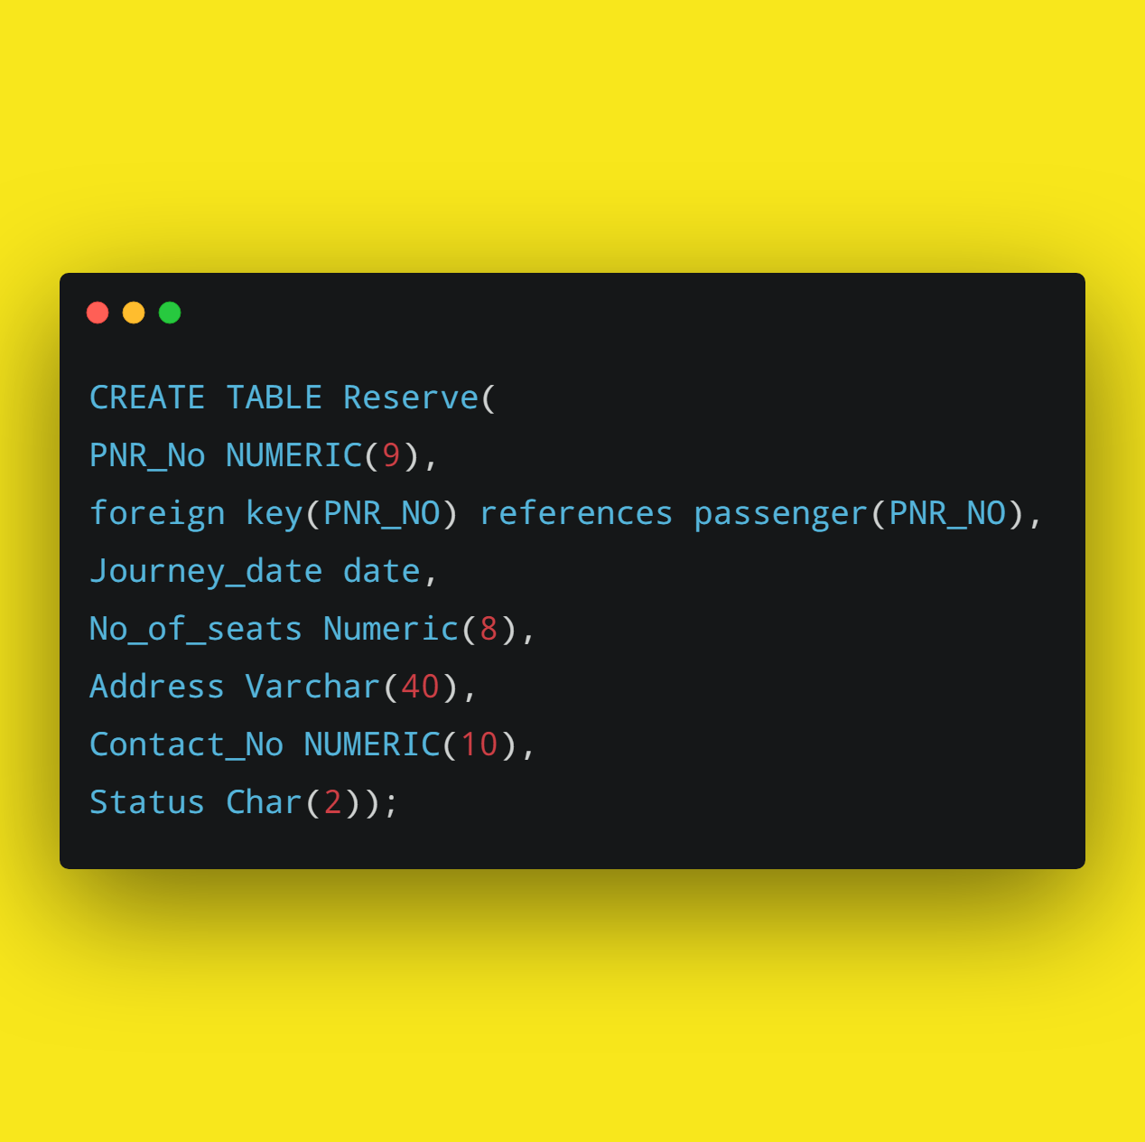
3.. Reserve : PNR_No (PK & FK -> Passenger), Journey_date,No_of_seats, Address, Contact_No, Status

Slide 13
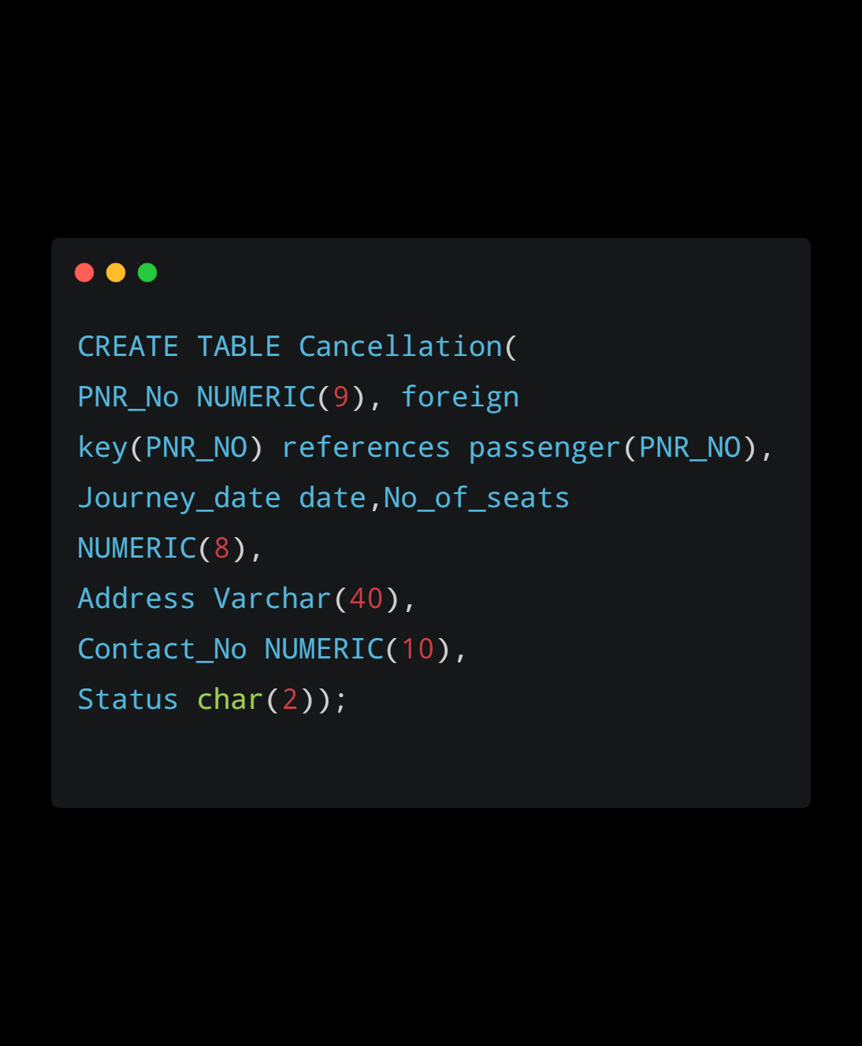
Cancellation: PNR_No(Foreign Key), Journey_date, No_of_seats, Address, Contact_No,Status

Slide 14
CANCELLATION TABLE
Cancellation Table: It used to sketches all reserved ticket with their required attributes like status of booked ticket , date of booking , no of seats, and their contact details.
ATTRIBUTE
PNR_NO : Passenger Name Record. FK references Passenger Table
Journey_Date :
No_of_seats : Explain This
Contact_No :
Status : Cancellation status of ticket

Slide 15
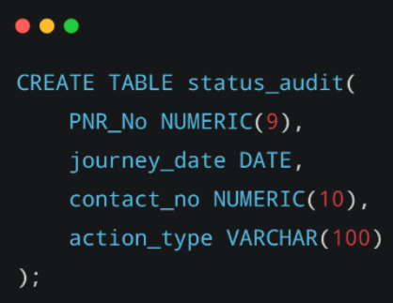
Status_Audit Table
It keeps track status of tickets more briefly what happens to tickets and such stuffs and helped us in Triggers part of this project.

Slide 16
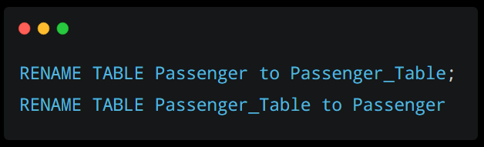
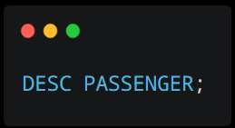
RENAME COMMAND
Sometimes we may want to rename our table to give it a more relevant name.
Syntax –
rename table <current_table_name> to <new_table_name>;
DESCRIBE COMMAND
DESCRIBE is used to describe something. Since in database we have tables, that’s why we use DESCRIBE or DESC(both are same) command to describe the structure of a table(like column headings, datatypes).

Slide 17
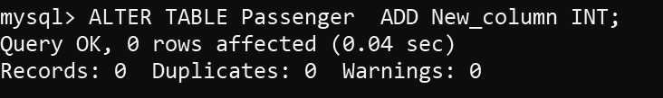
ALTER COMMAND
The ALTER TABLE statement is used to add, delete, or modify columns in an existing table.
The ALTER TABLE statement is also used to add and drop various constraints on an existing table.
ALTER TABLE - ADD Column
ADD is used to add columns into the existing table. Sometimes we may require to add additional information, in that case we do not require to create the whole database again, ADD comes to our rescue.

Slide 18
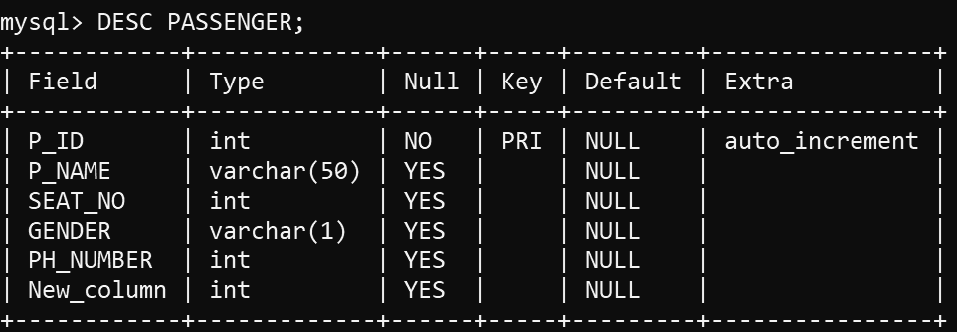
As we can see in output new column added in table

Slide 19
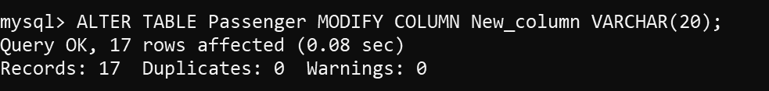
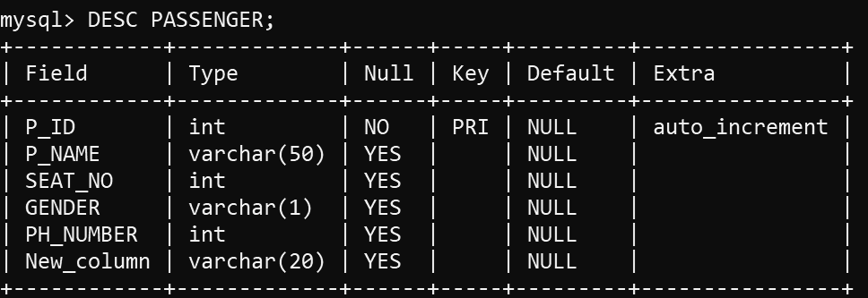
2. ALTER TABLE - MODIFY COLUMN
It is used to modify the existing columns in a table. Multiple columns can also be modified at once.
See finally we have changed datatype of New_column

Slide 20
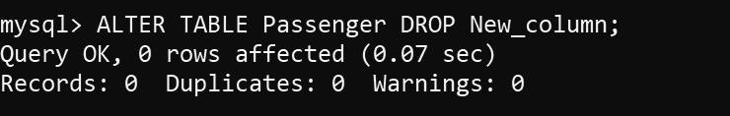
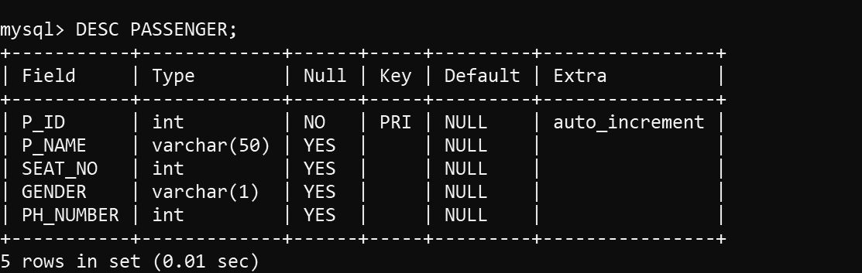
3. ALTER TABLE - DROP COLUMN
DROP COLUMN is used to drop column in a table. Deleting the unwanted columns from the table.
As we can see in table our previous col New_column deleted successfully

Slide 21
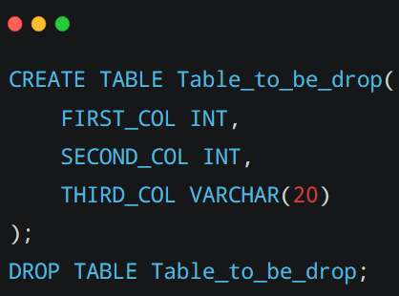
DROP COMMAND
DROP is used to delete a whole database or just a table.The DROP statement destroys the objects like an existing database, table, index, or view.
A DROP statement in SQL removes a component from a relational database management system (RDBMS).

Slide 22
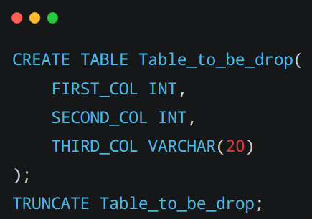
TRUNCATE COMMAND
TRUNCATE statement is a Data Definition Language (DDL) operation that is used to mark the extents of a table for deallocation (empty for reuse). The result of this operation quickly removes all data from a table, typically bypassing a number of integrity enforcing mechanisms.

Slide 23
DROP VS TRUNCATE COMMAND
Truncate is normally ultra-fast and its ideal for deleting data from a temporary table.
Truncate preserves the structure of the table for future use, unlike drop table where the table is deleted with its full structure.
Table or Database deletion using DROP statement cannot be rolled back, so it must be used wisely.

Slide 24
DML (DATA MANIPULATION LANGUAGE)
The DML commands change the data present in the SQL database. We can easily access, store, modify, update and delete the existing records from the database using DML commands.
Following are the four main DML commands in SQL:
SELECT Command
INSERT Command
UPDATE Command
DELETE Command

Slide 25
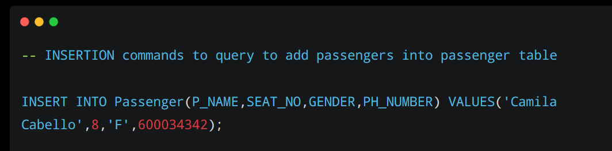
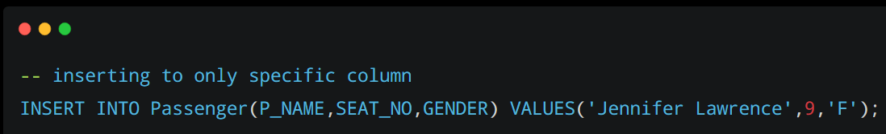
Insert command
Insert Data Only in Specified Columns

Slide 26
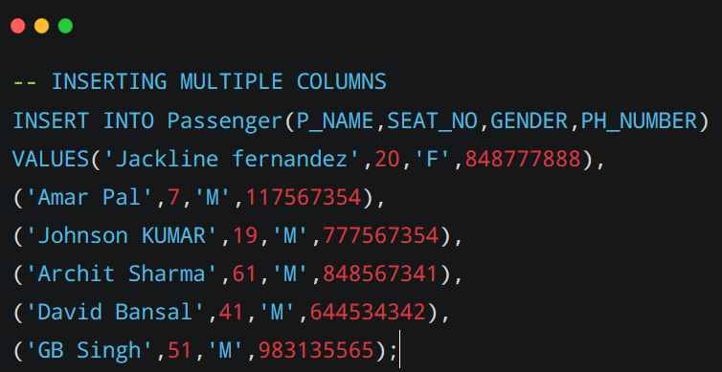
Insert Multiple Rows

Slide 27
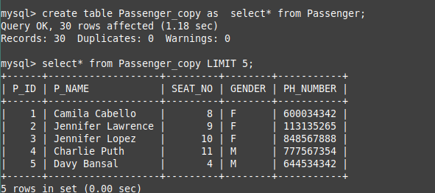
Create table from another table and limit clause

Slide 28
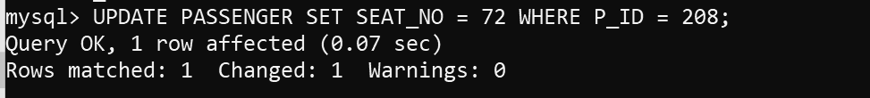
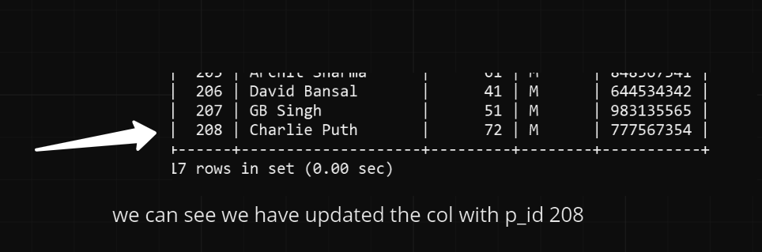
UPDATE COMMAND
The UPDATE statement is used to modify the existing records in a table.
The WHERE clause specifies which record(s) that should be updated. If we omit the WHERE clause, all records in the table will be updated!
Updating single column

Slide 29
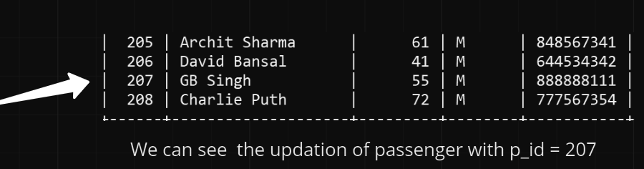
2. Updating multiple columns

Slide 30
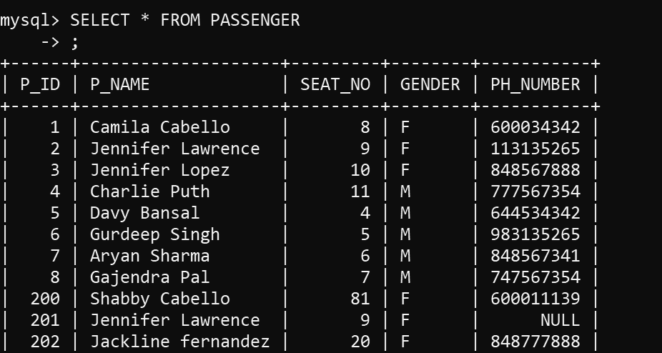
Select commands for all rows and all cols

Slide 31
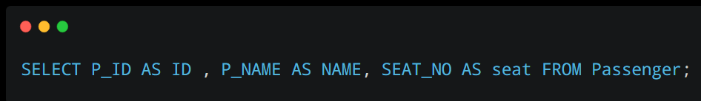
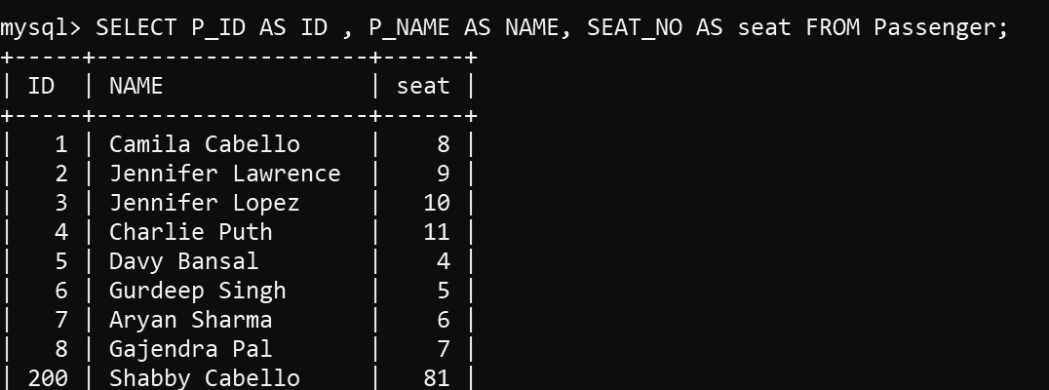
Select commands for all rows and specific cols

Slide 32
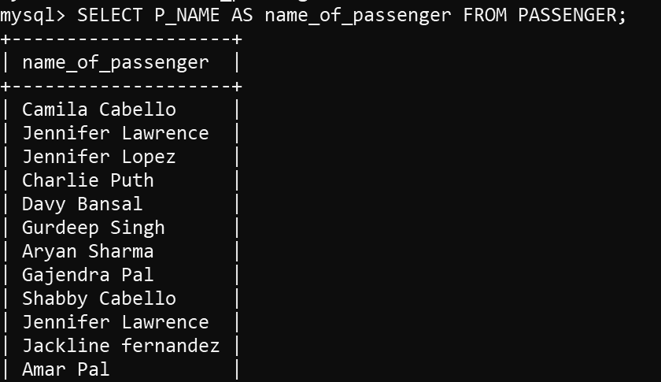
Select command for all rows and single col

Slide 33
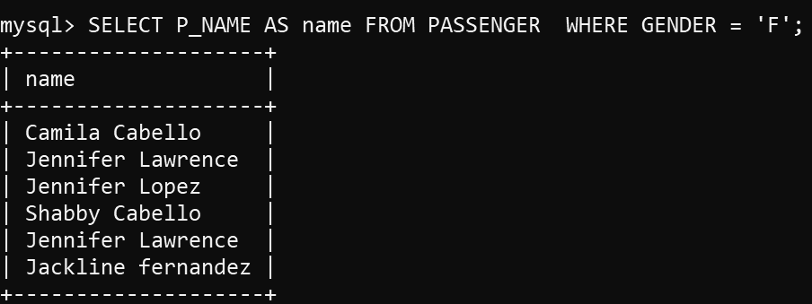
Select Commands with where clause

Slide 34
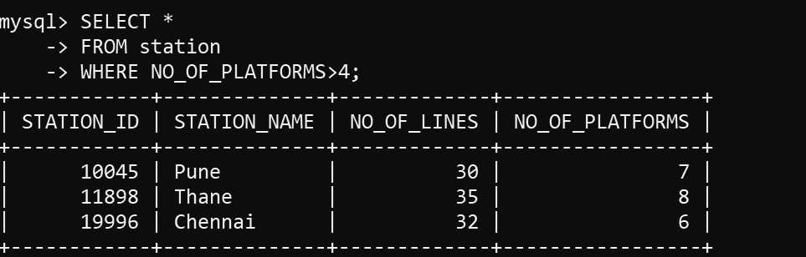
Select Commands With All Columns And Specific Rows

Slide 35
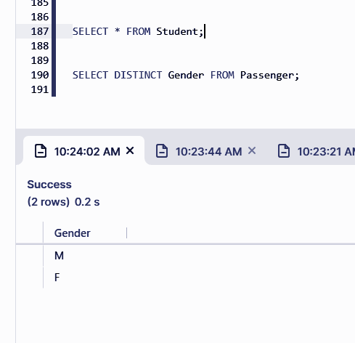
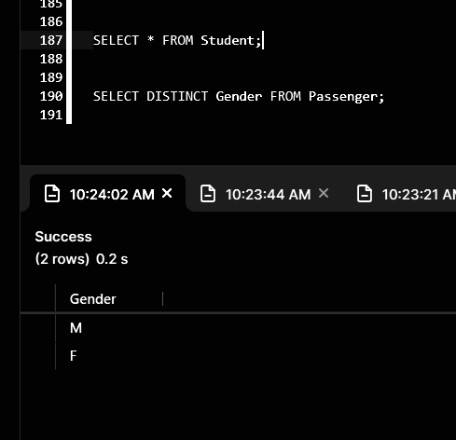
Select Commands With DISTINCT keyword
With this DISTINCT keyword we can select only distinct rows from a particular column.

Slide 36
DCL(DATA CONTROL LANGUAGE)
DCL COMMANDS ARE USED TO CONTROL PRIVILEGE IN THE DATABASE.
DCL COMMANDS ARE USED TO PERFORM WORK RELATED TO RIGHTS , PERMISSIONS IN THE DATABASE.
THE TWO MOST IMPORTANT DCL COMMANDS ARE:
1) GRANT -This command is used to grant permission to the user to perform a particular operation on a particular object.
2)REVOKE - This command is used to take permission/access back from the user. If you want to return permission from the database that you have granted to the users at that time you need to run REVOKE command.

Slide 37
ADVANTAGES OF DCL COMMANDS
It allows to restrict the unauthorized users from accessing data in database.
It ensures security in database when the data is exposed to multiple users.
It is the wholesome responsibility of the data owner or data administrator to maintain the authority of grant and revoke privileges to the users preventing any threat to data.
It prevents other users to make changes in database who have no access to Database

Slide 38
GRANT
It is employed to grant a privilege to a user. GRANT command allows specified users to perform specified tasks
Syntax
GRANT privilege_name on objectname to user;
Here,
privilege names are SELECT,UPDATE,DELETE,INSERT,ALTER,ALL
objectname is table name
user is the name of the user to whom we grant privileges

Slide 39
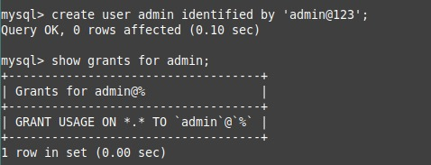
CREATING USERS IN MYSQL
Different Users with different permissions can be created in the database to enhance security and effectiveness within the database.
Syntax
create user USER_NAME identified by PASSWORD;
#Creating ADMIN ROLE IN THE DATABASE;
(NOTE: admin role is not DBA here)

Slide 40
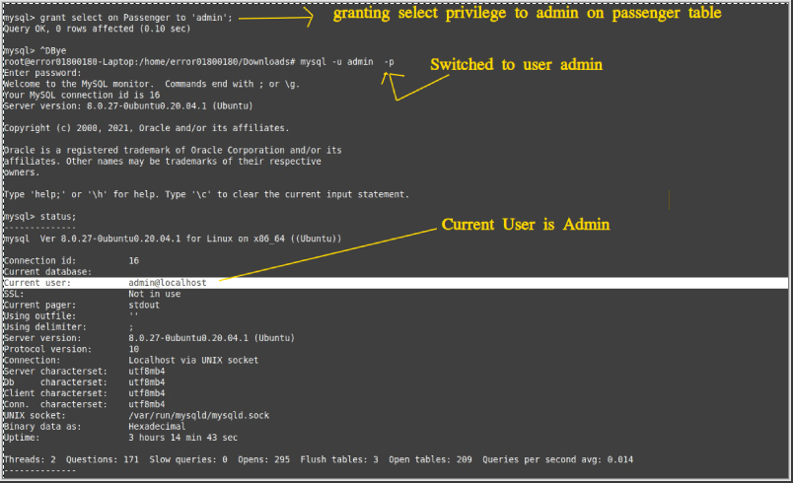

Slide 41
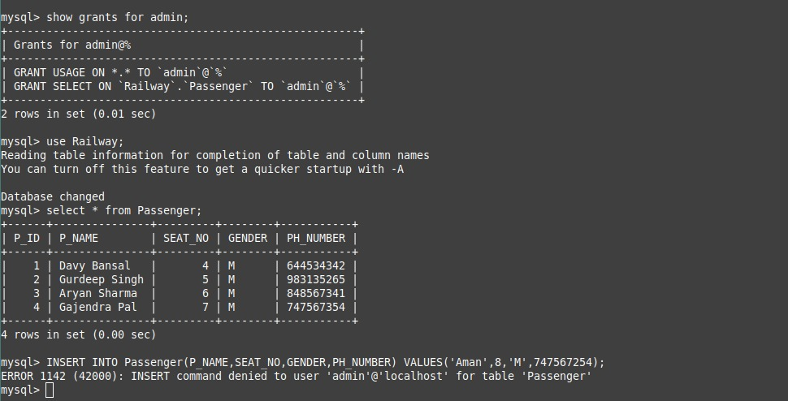
mysql>Show grants for admin; ->Shows all grants for the user admin.
We can notice that till this stage admin only has access to select statement.

Slide 42
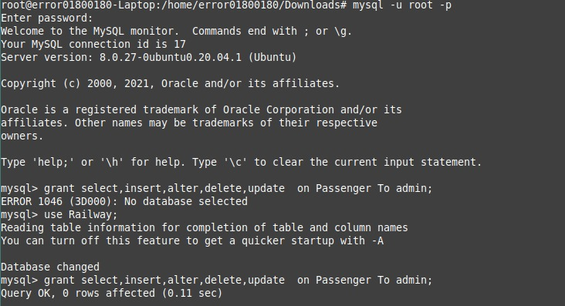
Granting insert,alter,delete,update permissions on table Passenger to admin role.

Slide 43
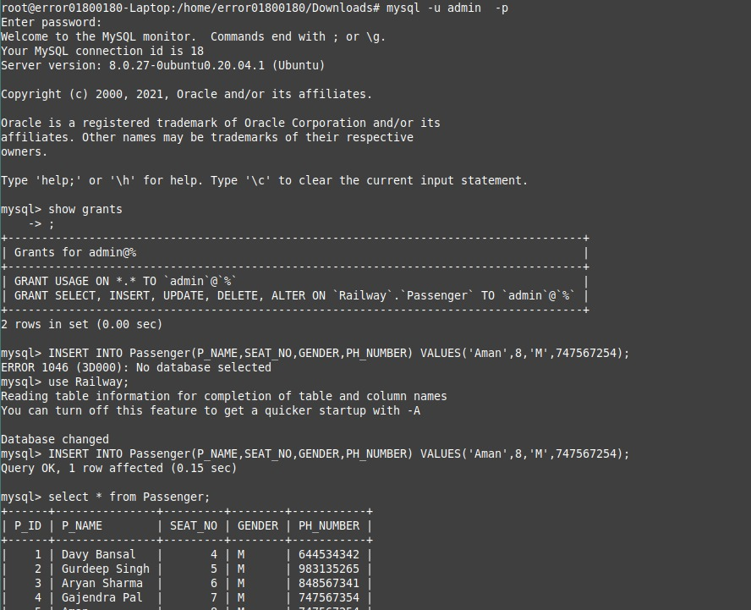
Grants given to admin And now admin can insert into the Passenger table;

Slide 44
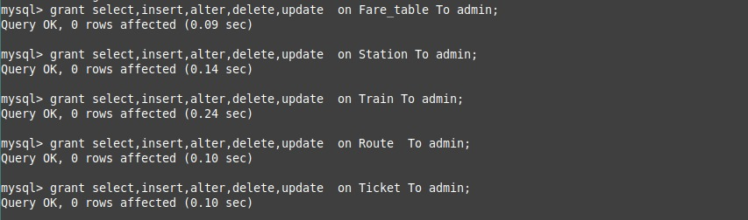
Granting insert,alter,delete,update permissions on different tables to admin role.

Slide 45
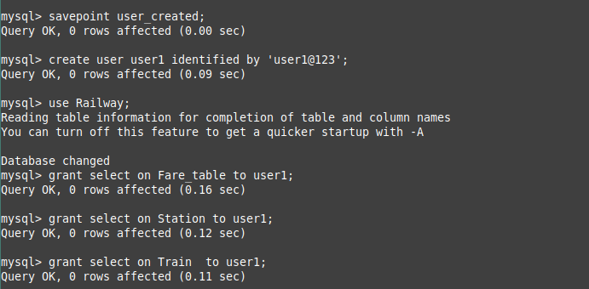
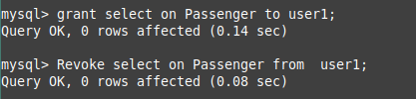
Revoking Permissions from users
Revoke:
Syntax:
REVOKE privilege_name on objectname from user;

Slide 46
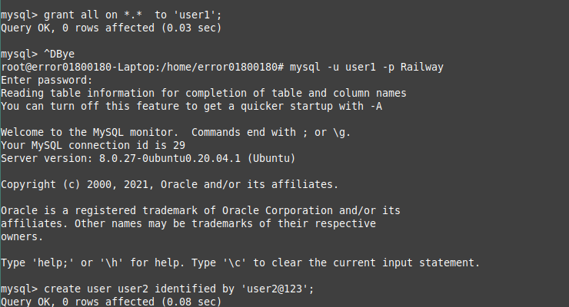
user1 further creating another user2
We can achieve this by creating a user with the same privilege as the root user.

Slide 47
TCL(TRANSACTION CONTROL LANGUAGE)
TCL manages transactions within the database.
SOME OF THE TCL COMMANDS ARE:
1)SAVEPOINT - The changes done till savpoint will be unchanged and all the transactions after savepoint will be rolled back.
2)ROLLBACK - It is used to restore the database to that state which was last committed.
3) COMMIT-It is used to save the transactions in the database.

Slide 48
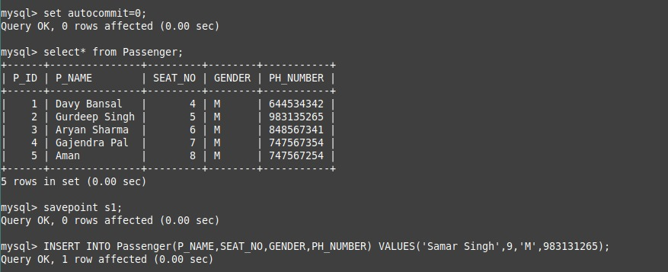
SAVPOINT AND ROLLBACK

Slide 49
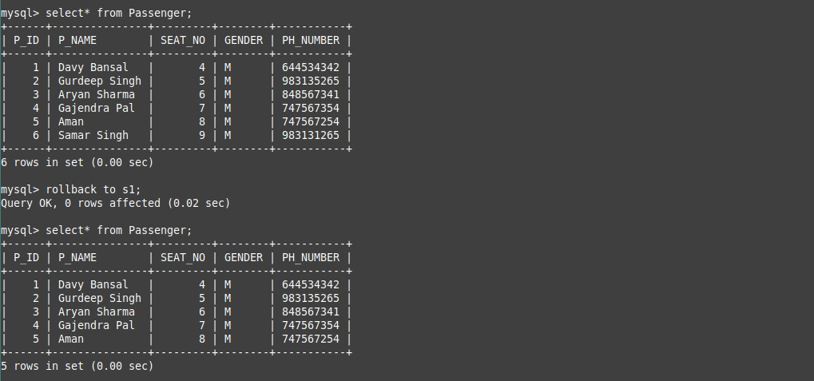
Rolling back to the savepoint.

Slide 50
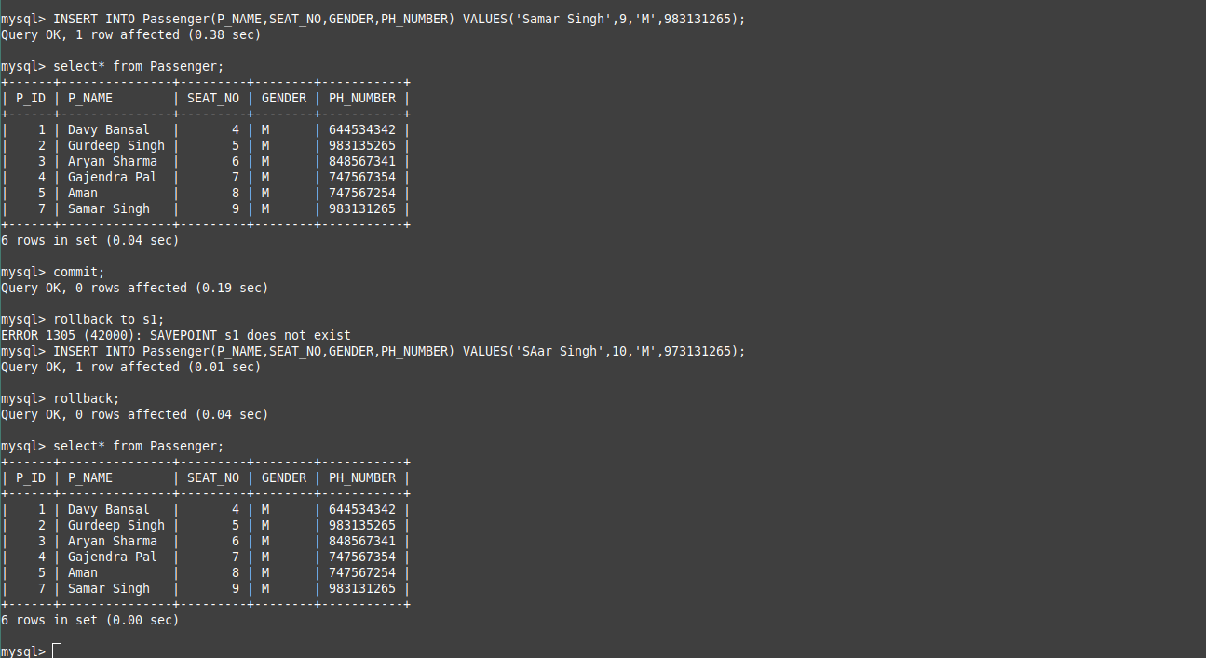
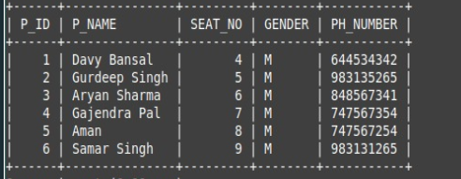
Committing to database so now changes are permanently made to database;
Rollback rolls back to the last made commit to the database.

Slide 51
DATA CONSTRAINTS
Constraints are the rules enforced on the data columns of a table. These are used to limit the type of data that can go into a table. This ensures the accuracy and reliability of the data in the database.
Constraints could be either on a column level or a table level. The column level constraints are applied only to one column, whereas the table level constraints are applied to the one or more columns in a table.
Constraints can be specified when a table is created with the CREATE TABLE statement or you can use the ALTER TABLE statement to create constraints even after the table is created.

Slide 52
DATA CONSTRAINTS
A.Naming of a constraint and why it’s important
#A general convention used for naming constraints is
<table name>_<column name>_<constraint type>
(1) If a query (insert, update, delete) violates a constraint, SQL will generate an error message that will contain the constraint name. If the constraint name is clear and descriptive, the error message will be easier to understand; if the constraint name is a random, it's less clear.
(2) If a constraint needs to be modified in the future , it's very hard to do if you don't know what it's named. (ALTER TABLE MyTable drop CONSTRAINT um...)

Slide 53
TYPES OF CONSTRAINTS
a)Column Level Constraints: A column level constraint references a single column
and is defined along with the definition of the column.Any constraint can
be defined at the column level except for a COMPOSITE primary key
constraint.
Syntax:
Column name datatype[CONSTRAINT constraint_name] constraint_type;
b)Table Level Constraints: A table level constraint references one or more columns
and is defined separately from the definitions of the columns.Normally, it
is written after all the columns are defined.
Syntax:
[CONSTRAINT constraint_name] constraint_type(Column names );
SQL - Operators (tutorialspoint.com)
Iss link par jo tables hai na unko slides par lana hai

Slide 54
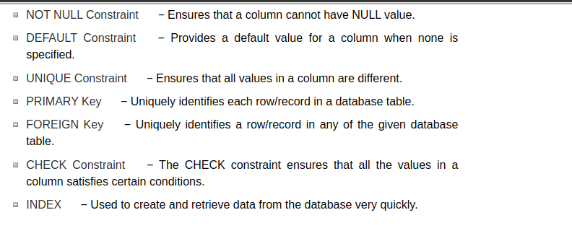
Some constraints available in SQL

Slide 55
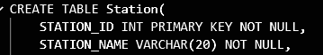
Some Constraints at Glance…
1)Not Null Constraint:
By default, a column can hold NULL values.
The NOT NULL constraint enforces a column to NOT accept NULL values.
This enforces a field to always contain a value, which means that you cannot insert a new record, or update a record without adding a value to this field.
Syntax for column level:
Attribute name datatype(size) CONSTRAINT constraint_name NOT NULL;

Slide 56
2) Default Constraint:
The DEFAULT constraint is used to set a default value for a column.
The default value will be added to all new records, if no other value is specified.
Syntax for column level:
Attribute name datatype(size) CONSTRAINT constraint_name DEFAULT <default value>,

Slide 57
3) Unique Constraint:
The UNIQUE constraint ensures that all values in a column are different.
Both the UNIQUE and PRIMARY KEY constraints provide a guarantee for uniqueness for a column or set of columns.
A PRIMARY KEY constraint automatically has a UNIQUE constraint.
However, you can have many UNIQUE constraints per table, but only one PRIMARY KEY constraint per table.
Syntax for column level:
Attribute name datatype(size) CONSTRAINT constraint_name UNIQUE;
Syntax for table level:
CONSTRAINT constraint name UNIQUE(column names),

Slide 58


4) Primary Key Constraint:
The PRIMARY KEY constraint uniquely identifies each record in a table.
Primary keys must contain UNIQUE values, and cannot contain NULL values.
A table can have only ONE primary key; and in the table, this primary key can consist of single or multiple columns (fields).
Syntax for column level:
Attribute name datatype(size) CONSTRAINT
constraint_name PRIMARY KEY;
Syntax for Table level:
CONSTRAINT constraint name PRIMARY KEY(column names);

Slide 59

5) Foreign Key Constraint:
The FOREIGN KEY constraint is used to prevent actions that would destroy links between tables.
A FOREIGN KEY is a field (or collection of fields) in one table, that refers to the PRIMARY KEY of another table or of the same table.
The table with the foreign key is called the child table, and the table with the primary key is called the referenced or parent table.
Syntax :
[CONSTRAINT [symbol]] FOREIGN KEY
[index_name] (col_name, ...)
REFERENCES tbl_name (col_name,...)
[ON DELETE reference_option]
[ON UPDATE reference_option]

Slide 60

6) Check Constraint:
The CHECK constraint is used to limit the value range that can be placed in a column or the value must satisfies some condition.
If you define a CHECK constraint on a column it will allow only certain values for this column.
If you define a CHECK constraint on a table it can limit the values in certain columns.
Syntax for column level:
Attribute name datatype(size) CONSTRAINT constraint_name CHECK( condition );
Syntax for table level:
CONSTRAINT constraint name
CHECK (column names);
CHECK (GENDER=’M’ OR GENDER=’F’ OR GENDER=’T’);

Slide 61
What is a foreign key with ON DELETE CASCADE & ON UPDATE CASCADE
A foreign key with ON DELETE CASCADE means that if a record in the parent table is deleted, then the corresponding records in the child table will automatically be deleted.
—A foreign key with cascade delete can be created using either a CREATE TABLE statement or with an ALTER TABLE statement if we forgot to add it while creating table.
A foreign key using ON UPDATE CASCADE is also useful as the referencing rows are updated in the child table when the referenced row is updated in the parent table which has a primary key.
—A foreign key with cascade update can also be created in the same way as cascade delete using either a CREATE TABLE statement or with an ALTER TABLE statement if we forgot to add it while creating table.
We have created Ticket <->Fare_table and Passenger<->Ticket Tables with this property.

Slide 62
What is a foreign key with ON DELETE SET NULL & ON UPDATE SET NULL
A foreign key with ON DELETE SET NULL means that if a record in the parent table is being deleted, then the foreign key attribute value in corresponding record in the child table will set to NULL if it is allowed.
—A foreign key with on delete set NULL can be created using either a CREATE TABLE statement or with an ALTER TABLE statement if we forgot to add it while creating table.
A foreign key using ON UPDATE SET NULL is also useful as the foreign key attribute value in corresponding record in the child table will set to NULL if it is allowed when the referenced row is updated in the parent table which has a primary key.
—A foreign key with on update set can also be created in the same way as on delete set NULL using either a CREATE TABLE statement or with an ALTER TABLE statement if we forgot to add it while creating table.

Slide 63
SQL OPERATORS
OPERATORS: An operator is a reserved word or a character used primarily in an SQL statement WHERE clause to perform operation(s), such as comparisons and arithmetic operations. These Operators are used to specify conditions in an SQL statement and to serve as conjunctions for multiple conditions in a statement.
Arithmetic operators
Comparison operators
Logical operators

Slide 64

ARITHMETIC OPERATORS
Arithmetic operators can perform arithmetical operations on numeric operands involved. These operators are used to manipulate mathematical calibrations like addition, multiplication, division, subtraction and other modulus numeric values in the SQL query. Arithmetic operators are addition(+), subtraction(-), multiplication(*), division(/) and modulo(%).

Slide 65



We can also add integer and strings like below:
If we mix data types such as INT and VARCHAR, SQL Server will always attempt to convert everything to the one that has the highest precedence.
Used Arithmetic operators

Slide 66

SQL Comparison Operators
A comparison (or relational) operator is a mathematical symbol which is used to compare two values.
Comparison operators are used in conditions that compares one expression with another. The result of a comparison can be TRUE, FALSE

Slide 67



EQUAL TO OPERATOR(=)
GREATER THAN(>)
LESS THAN(<)

Slide 68



4.GREATER THAN OR EQUAL(>=)
5. LESS THAN OR EQUAL TO(<=)
6. NOT EQUAL TO(<>)

Slide 69

SQL LOGICAL OPERATOR
Here is a list of all the logical operators available in SQL.

Slide 70


AND OPERATOR - The AND operator allows the existence of multiple conditions in an SQL statement's WHERE clause.
OR OPERATOR - The OR operator is used to combine multiple conditions in an SQL statement's WHERE clause.

Slide 71


3. NOT OPERATOR - The NOT operator reverses the meaning of the logical operator with which it is used. Eg: NOT BETWEEN, NOT IN, etc.
4.. ALL OPERATOR - The ALL operator is used to compare a value to all values in another value set.

Slide 72


5. LIKE OPERATOR - The LIKE operator is used to compare a value to similar values using wildcard operators.
Match pattern and filter the result as per pattern which satisfies the result.
String pattern:-
% indicates any number of characters whereas _ indicates single character
['b%' -> starts with b or B]
['%b%' -> b somewhere in string]
['%y' -> ends with y]
[_y -> 2 character string ending with y]
[b__y -> string having 4 characters which starts with b and ends with y]

Slide 73


6. IS NULL OPERATOR - The NULL operator is used to compare a value with a NULL value.

Slide 74



7. ANY OPERATOR - The ANY operator is used to compare a value to any applicable value in the list as per the condition.
8. BETWEEN OPERATOR - The BETWEEN operator is used to search for values that are within a set of values, given the minimum value and the maximum value.

Slide 75

9. IN OPERATOR - The IN operator is used to compare a value to a list of literal values that have been specified.

Slide 76

FUNCTIONS
MySQL comes bundled with a number of built in functions. Built in functions are simply functions come already implemented in the SQL. These functions allow us to perform different types of manipulations on the data.
NUMERIC FUNCTIONS

Slide 77


2.
3.

Slide 78


4.
5.

Slide 79


6.
7.

Slide 80

STRING FUNCTIONS

Slide 81



2.
3.
4
5

Slide 82


6.
7..
8.

Slide 83


9.
10.
If the substring is not found within the original string, this function returns 0.
This function performs a case-insensitive search.

Slide 84


11.
12.

Slide 85

|| Operator to Concatenate Strings
Setting sql_mode to PIPES_AS_CONCAT or ANSI enables || to concatenate strings:

Slide 86


DATE FUNCTIONS:-
SYSDATE() FUNCTION: This function returns the time at which the function executes.
CURDATE() AND CURTIME() FUNCTION - CURDATE function returns the current date and CURTIME function returns the current time.

Slide 87
DATE() FUNCTION - Extracts the date part of the date.
MONTH() FUNCTION- Returns the month for date.
MONTHNAME() FUNCTION- Returns the name of month for date.
YEAR() FUNCTION- Returns the year for date.
DAYNAME()- Returns the name of the weekday for date.
DAYOFMONTH()- Returns the day of the month for date.
DAYOFWEEK()-Returns the day weekday index for date.
DAYOFYEAR()-Returns the day of the year for date.

Slide 88


Difference between SYSDATE() and NOW():-
NOW() function - Returns a steady time that indicates the time at which the particular statement began to execute.
SYSDATE() function- Returns the accurate time at which the statement executes.

Slide 89


Aggregate Function
SQL aggregation is the task of collecting a set of values to return a single value. It is done with the help of aggregate functions, such as SUM, COUNT, and AVG. For example, in a database of products, you might want to calculate the average price of the whole inventory.

Slide 90


Aggregate (count())

Slide 91



Aggregate (AVG)

Slide 92




Aggregate(Max() , Min())

Slide 93

ORDER BY(Increasing(Default))
The ORDER BY keyword is used to sort the result-set in ascending or descending order.
The ORDER BY keyword sorts the records in ascending order by default. To sort the records in descending order, use the DESC keyword.

Slide 94

Order by (Descending )

Slide 95

Order by (Combined )

Slide 96

Order by (column no)

Slide 97

Group By
The SQL GROUP BY clause is used in collaboration with the SELECT statement to arrange identical data into groups. This GROUP BY clause follows the WHERE clause in a SELECT statement and precedes the ORDER BY clause.

Slide 98


Slide 99

Having By
The HAVING clause is often used with the GROUP BY clause to filter groups based on a specified condition. If you omit the GROUP BY clause, the HAVING clause behaves like the WHERE clause.

Slide 100


Slide 101
SUBQUERIES
A Subquery or Inner query or a Nested query is a query within another SQL query and embedded within the WHERE clause.
A subquery is used to return data that will be used in the main query as a condition to further restrict the data to be retrieved.
Subqueries can be used with the SELECT, INSERT, UPDATE, and DELETE statements along with the operators like =, <, >, >=, <=, IN, BETWEEN, etc.
Syntax:
SELECT column_name [, column_name ]
FROM table1 [, table2 ]
WHERE column_name OPERATOR
(SELECT column_name [, column_name ]
FROM table1 [, table2 ]
[WHERE])

Slide 102

Single Row,Multiple Row,Multiple Column Subqueries
Multiple Row & Multiple Column

Slide 103

Subqueries With Insert Statement
INSERT statement can be used with subqueries.

Slide 104

AFTER INSERTION USING SUBQUERY

Slide 105

Subqueries With Update Statement
[ WHERE OPERATOR [ VALUE ]
(SELECT COLUMN_NAME
FROM TABLE_NAME)
[ WHERE) ]

Slide 106

Subqueries With Delete Statement

Slide 107

Subqueries in a Select Clause

Slide 108

Subqueries in a From Clause
We Can place a subquery in the FROM clause of an outer query.

Slide 109
JOINS
A SQL Join statement is used to combine data or rows from two or more tables based on a particular column to get a required result.
Different types of Joins are as follows:
INNER JOIN
CROSS JOIN
SELF JOIN
OUTER JOIN

Slide 110

.
Natural Join

Slide 111


CROSS JOIN
It is a join which returns the Cartesian Product of rows from the tables in the Join.In other words, it combines each row from the first table with each row from second table.

Slide 112
INNER JOIN
The INNER JOIN keyword selects all rows from both the tables as long as the condition satisfies.Inner Join mainly results the Intersection of tables. Types of Inner join:
1.Natural join
2.Equi Join

Slide 113


NATURAL JOIN
The NATURAL JOIN is an operation that creates join on the basis of common columns in a table and the value of that common attribute must be equal.To perform Natural Join there must be atleast one common attribute between tables to join.

Slide 114


EQUI JOIN
An equi-join is a join based on equality or matching column values. This equality is indicated with an equal sign (=) as the comparison operator in the WHERE clause.It is same as NATURAL JOIN but the only difference is that in EQUI JOIN we can equate any column from both the tables

Slide 115


SELF JOIN
In Self-Join a table joined with itself. That is, each row of the table is joined with itself depending on some conditions. Mainly it is a join between two copies of the same table.

Slide 116
OUTER JOIN
The OUTER JOIN returns matching rows as well as unmatched rows from one or both the tables.Outer Join mainly results the Union of tables. Types of Outer join:
1.Left Outer Join
2.Right Outer Join
3.Full Outer Join

Slide 117


LEFT OUTER JOIN
This join returns all the rows of the table on the left side of the join and matching rows for the table on the right side of join. The rows for which there is no matching row on right side, the result-set will contain null.

Slide 118


RIGHT OUTER JOIN
This join returns all the rows of the table on the right side of the join and matching rows for the table on the left side of join. The rows for which there is no matching row on left side, the result-set will contain null.

Slide 119


FULL OUTER JOIN
FULL JOIN creates the result-set by combining result of both LEFT JOIN and RIGHT JOIN. The result-set will contain matching rows and all the rows from both the tables. The rows for which there is no matching, the result-set will contain NULL values

Slide 120
Views
Views in SQL are kind of Virtual tables.A view also has rows and columns as they are in a real table in the Database.We can create a view by selecting fields from one or more tables present in the database.A view can either have all the rows and columns of a table or some specific based on a certain condition.
Advantages of views over tables:
-Views provide table security by restricting access to predetermined set of rows and columns.
-Views can join and simplify multiple tables into a single virtual table.
-Views can also be used to rename the columns without affecting the base table provided the number of columns in view must match the number of columns specified in the SELECT statement.Renaming helps to hide the actual column names of Base table.
-We can create multiple Views on the same table for different users.

Slide 121
CREATING VIEWS
We can create the view using CREATE VIEW statement.A view can be created from a single table or multiple tables.SYNTAX-
CREATE VIEW view_name AS
SELECT column1, column2.....
FROM table_name
WHERE condition;
view_name: Name for the View
table_name: Name of the table
condition: Condition to select rows

Slide 122


Creating views from single table
In this we creates a view named Passenger_View from Passenger table which will show only two columns of Passenger table. Syntax-

Slide 123


Creating views from more than one table
In this we create a view named Full_Join_View from two tables named Passenger and Ticket. To create a view from multiple tables we have use Full outer join on the two tables and store the result in a view. Syntax-

Slide 124



DELETING VIEWS
-This is used to delete the existing view.
Syntax- DROP VIEW view_name;
AFTER DROPPING VIEW

Slide 125
UPDATING VIEWS
This UPDATION CAN BE-
1. RENAME view name.
2. Inserting a COLUMN into a view.
3. Deleting COLUMN from a view
4. RENAME COLUMN names.
5. Inserting a ROW into a view.
6. Deleting a ROW from a view.
7. Updating a particular ROW in a view.

Slide 126


ADDING OR REMOVING COLUMNS IN A VIEW
We can use the CREATE OR REPLACE VIEW statement to add or remove fields from a view.The same statement is also used for changing the name of a view, changing its column names.Query as follows:
COLUMN ADDED

Slide 127


Inserting a row in a view
1.We can insert a row in a View in a same way as we do in a table. We can use the INSERT INTO statement of SQL to insert a row in a View. The changes will also be made in the table itself also apart from the virtual table. The syntax for it is as follows:
ROW INSERTED

Slide 128



EFFECT ON ACTUAL TABLE AFTER INSERTION IN VIEW
BEFORE INSERTION AFTER INSERTION
ROW INSERTED IN ACTUAL TABLE ALSO

Slide 129


Deleting a row from a View
Deleting rows from a view is also as simple as deleting rows from a table. We can use the DELETE statement of SQL to delete rows from a view. Also deleting a row from a view first delete the row from the actual table and the change is then reflected in the view.
ROW DELETED

Slide 130

EFFECT ON ACTUAL TABLE AFTER DELETION IN VIEW
BEFORE DELETION AFTER DELETION
ROW DELETED FROM ACTUAL TABLE ALSO

Slide 131
Updating a row in a View
For updating a row in a view there is one condition i.e. the view must be an updatable view.
–Updatable view is a view which contains all the NOT NULL columns from the underlying table.
If so, we can update a row in a view which also affects the data on the actual table.
We can UPDATE a row in a View in a same way as we do in a table. We can use the UPDATE statement of SQL to UPDATE a row in a View. The changes will also be made in the table itself also apart from the virtual table. The syntax for it is as follows:
UPDATE view_name SET column1=___ , column2=___ , … WHERE condition;

Slide 132




BEFORE UPDATION AFTER UPDATION
ROW UPDATED

Slide 133




EFFECT ON ACTUAL TABLE AFTER UPDATION IN VIEW
BEFORE UPDATION AFTER UPDATION
ROW UPDATED
IN ACTUAL TABLE ALSO

Slide 134

SEQUENCES
A sequence is a object that generates a sequence of numeric values according to the specification with which the sequence was created.
The sequence of numeric values is generated in an ascending or descending order at a defined interval and can be configured to restart (cycle) when exhausted.
SYNTAX:
Notes:
Do not make this black

Slide 135
SEQUENCES
P_ID_GENERATOR
For Passenger ID (P_ID)
TICKET_NO_GENERATOR
For Ticket_NO

Slide 136


P_ID_GENERATOR : Sequence for Generating values starting from 1
We initialize and get the values from the sequence using the SEQUENCE_NAME.nextval -> Increments the sequence and return the value
SEQUENCE_Name.currval -> returns the latest value in sequence

Slide 137


OUTPUT : Passenger Table
P_ID Generator Sequence

Slide 138




TICKET_NO_GENERATOR : Generates Unique Ticket No starting from Start Value = 1000
OUTPUT: Tickets Table
Generated Ticket No

Slide 139


ALTER SEQUENCE
A sequence can be altered and following properties can be changed:
Increment by
Max Value
Min Value
Order
CACHE
CYCLE
Altering sequence only affects, the future values in the sequence
EX: we want to skip a P_ID by changing the increment factor to 2 (earlier was 1)
OUTPUT: Passenger Table
Generating P_ID from Altered Sequence

Slide 140
INDEXES
Indexes are one of the most important performance optimization features of SQL
Indexes are used by queries to find data from tables quickly. Indexes are created on tables and views. Index on a table or a view, is very similar to an index that we find in a book.
The set of right indexes can drastically improve the performance of the query, and prevents the Table Scan Problem.
Types of Indexes:
Clustered :
Order of rows in index determines/matches the actual physical order of data
Do not claim extra storage
Non - Clustered :
Order of rows in index does not match with the physical order of data
Stored separately, have pointers pointing to physical rows
Unique :
Enforce the unique constraint on key column(s)
Duplicate :
Duplicate indexes are those that exactly match the Key and Included columns
Simple : Include Single key Column
Composite : Includes more than one key Column

Slide 141

UNIQUE INDEX (Simple)
Unique_seat Index
Passenger Table
SEAT_NO | Pointer to Row
4
5
6
7
8
9
10
11
Use Case :
To Ensure no passenger have duplicate seat
Composite and Unique

Slide 142

Unique Index Enforces Unique constraint on the key column(s)
E.x - If we try to insert another passenger with same seat, an error is generated
Passenger Table

Slide 143
Duplicate Index (Simple)
Duplicate indexes are those that exactly match the included columns and order, but have different name and claim their own storage.
E.x: we create an another Index which optimizes the search queries involving SEAT_NO
Similar to Unique_Seat Index we created earlier
Output:

Slide 144
Unique_Seat
Unique_Seat_Passenger
SEAT_NO | Pointer to Row
4
5
6
7
8
9
10
11
Pointer to Row | SEAT_NO
 | 4
 | 5
 | 6
 | 7
 | 8
 | 9
 | 10
 | 11
Passenger Table
Database should never have Duplicate Indexes because they affect the performance as each duplicate index needs to be modified after insertion,deletion or update operation and takes extra storage

Slide 145
Simple Index
Use Case: Optimize Queries involving Passenger Names
P_NAME_Optimize
P_NAME | Pointer to row
Aryan Sharma
Camila Cabello
Charlie Puth
Davy Bansal
Gajendra Pal
Gurdeep Singh
Jennifer Lawrence
Jennifer Lopez

Slide 146

COMPOSITE INDEX
Creating Index on Fair Table for CLASS and FARE Column
Use Case : Optimize queries for Class and Fare
Fair_by_class Index
Fair Table
CLASS | Fare | Pointer to Row
First | 250
First | 660
Second | 100
Third | 500

Slide 147
PL/SQl
PL/SQL is a block structured language that enables developers to combine the power of SQL with procedural statements.All the statements of a block are passed to oracle engine all at once which increases processing speed and decreases the traffic.
Disadvantages of SQL:
SQL doesn’t provide the programmers with a technique of condition checking, looping and branching.
SQL statements are passed to Oracle engine one at a time which increases traffic and decreases speed.
SQL has no facility of error checking during manipulation of data..

Slide 148
Features of PL/SQL:
PL/SQL is basically a procedural language, which provides the functionality of decision making, iteration and many more features of procedural programming languages.
PL/SQL can execute a number of queries in one block using single command.
One can create a PL/SQL unit such as procedures, functions, packages, triggers, and types, which are stored in the database for reuse by applications.
PL/SQL provides a feature to handle the exception which occurs in PL/SQL block known as exception handling block.
Applications written in PL/SQL are portable to computer hardware or operating system where Oracle is operational.
PL/SQL Offers extensive error checking.

Slide 149
Differences between SQL and PL/SQL:
SQL | PL/SQL
SQL is a single query that is used to perform DML and DDL operations | PL/SQL is a block of codes that used to write the entire program blocks/ procedure/ function, etc.
It is declarative, that defines what needs to be done, rather than how things need to be done. | PL/SQL is procedural that defines how the things needs to be done.
Execute as a single statement. | Execute as a whole program.
Mainly used to manipulate data. | Mainly used to create application.
Cannot contain PL/SQL code in it. | It is an extension of SQL,so it can contain SQL inside it.

Slide 150

Structure of PL/SQL Block:
PL/SQL extends SQL by adding constructs found in procedural languages, resulting in a structural language that is more powerful than SQL. The basic unit in PL/SQL is a block. All PL/SQL programs are made up of blocks, which can be nested within each other.

Slide 151


PROCEDURES IN PL/SQL
A stored procedure in PL/SQL is a series of SQL statements which can be stored in the database catalogue and can be reused.. A procedure can be thought of as a function or a method which may or may not returns a value.ALL statements of a block are passed to Oracle engine all at once which increases processing speed and decrease traffic. SYNTAX:
OUTPUT

Slide 152
Advantages:
They result in performance improvement of the application. If a procedure is being called frequently in an application in a single connection, then the compiled version of the procedure is delivered.
They reduce the traffic between the database and the application, since the lengthy statements are already fed into the database and need not be sent again and again via the application.
They add to code reusability, similar to how functions and methods work in other languages such as C/C++ and Java.
Disadvantages:
Stored procedures can cause a lot of memory usage.
MySQL does not provide the functionality of debugging the stored procedures.

Slide 153
CURSOR
Def: Cursors are used to store Database Tables. There are two types of cursors
Implicit Cursors: Default Cursors of SQL SERVER. These Cursors are allocated by SQL SERVER when the user performs DML operations.
Explicit Cursors: Explicit Cursors are Created by Users whenever the user requires them. Explicit Cursors are used for Fetching data from Table in Row-By-Row Manner.

Slide 154


A Cursor is being used to count no of Passengers and output it to the consol by fetching it from table Passenger.
OUTPUT:

Slide 155
Packages
Packages are schema objects that group logically related PL/SQL types, variables,functions,procedures,cursors and subprograms under a single unit.
A package has two mandatory parts-
Package Specification or Declaration
Package Body or Definition
Package Specification-The specification is the interface to the package. It just DECLARES the types, variables, constants, exceptions, cursors, and subprograms that can be referenced from outside the package. In other words, it contains all information about the content of the package, but excludes the code for the subprograms.

Slide 156

Syntax-
CREATE OR REPLACE PACKAGE package_name IS
PROCEDURE proc_name(parameters);
FUNCTION func_name(parameters) RETURN type;
END package_name;

Slide 157
Package Body- The package body has the codes for various methods declared in the package specification and other private declarations, which are hidden from the code outside the package. The CREATE PACKAGE BODY Statement is used for creating the package body.
SYNTAX-
CREATE OR REPLACE PACKAGE BODY package_name IS
PROCEDURE proc_name (parameters) IS
BEGIN
Executable code
END proc_name;
END package_name;

Slide 158

.

Slide 159
Triggers
Our trigger part works when someone updates cancellation table which means when someone request for cancellation of tickets..
generally
Trigger is a statement that a system executes automatically when there is any modification to the database. In a trigger, we first specify when the trigger is to be executed and then the action to be performed when the trigger executes.

Slide 160


Slide 161
Exception Handling
An exception is an error condition during a program execution. PL/SQL supports programmers to catch such conditions using EXCEPTION block in the program and an appropriate action is taken against the error condition. There are two types of exceptions −
System-defined exceptions
User-defined exceptions

Slide 162
System Defined Exception
These exceptions are predefined in PL/SQL which get raised WHEN certain database rule is violated.
System-defined exceptions are further divided into two categories:
Named system exceptions.
Unnamed system exceptions.
Named system exceptions: They have a predefined name by the system like ACCESS_INTO_NULL, DUP_VAL_ON_INDEX, LOGIN_DENIED etc.
Unnamed system exceptions:Oracle doesn’t provide name for some system exceptions called unnamed system exceptions.

Slide 163

SYSTEM DEFINED EXCEPTIONS :

Slide 164

User defined exceptions :
This type of users can create their own exceptions according to the need and to raise these exceptions explicitly raise command is used.

Slide 165


Slide 166


Slide 168

While Inserting data, We have made a trigger to check whether PNR_NO is valid or not and also is seats are available or not. If any of the above condition fails then we raise exception

Slide 169


